Slide 1
13

Slide 2
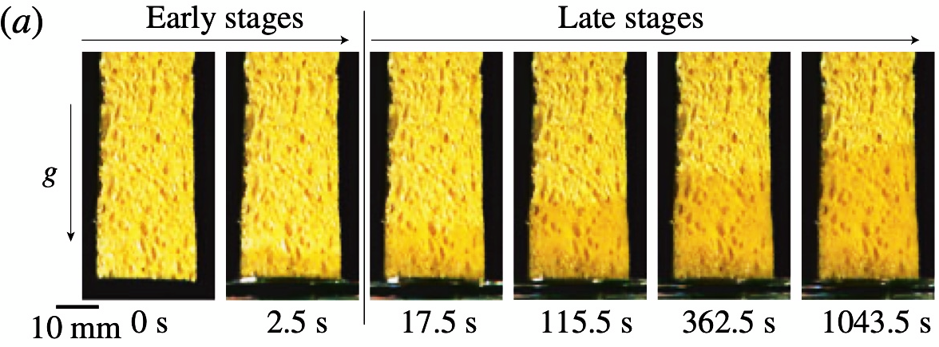
Sponge
A sponge will soak up water at a rate and in a quantity determined by various parameters.
Investigate how effective a sponge is at drying a wet surface.
Kim, J., Ha, J., & Kim, H. (2017). Capillary rise of non-aqueous liquids in cellulose sponges. Journal of Fluid Mechanics, 818, R2. doi:10.1017/jfm.2017.165

Slide 3
A sponge will soak up water at a rate and in a quantity determined by various parameters.
1
Why does a sponge soak up water?
2
What parameters affect the phenomenon?
Investigate how effective a sponge is at drying a wet surface.
3
Experimental investigation of the effectiveness.

Slide 4
Capillary explanation
The sponge is made out of a net of capillaries soaking up liquid due to capillary action.

Slide 5
Capillary explanation
The sponge is made out of a net of capillaries soaking up liquid due to capillary action.

Slide 6
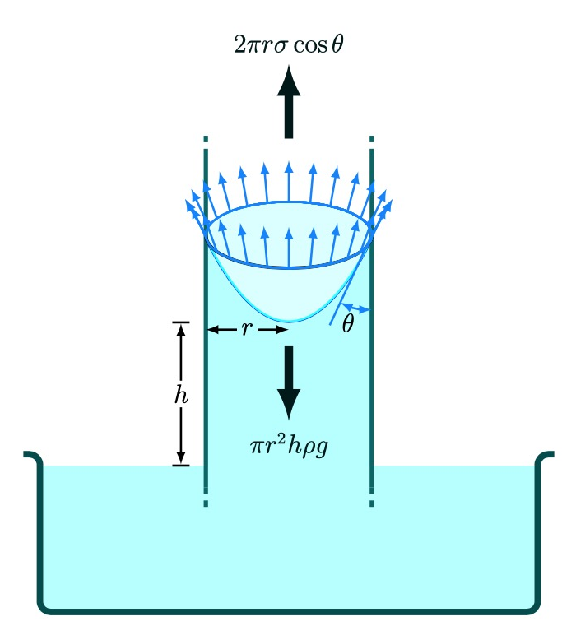
Capillary action in a tube
$$F_{total}=Force_{up}−Force_{down}$$
$$F_{total}=2πrσ\cos{θ}−πr^{2}hρg$$
Soaked up volume V
Taking out $πr$ and dividing by m
$$\ddot{h}=\frac{πr}{m}\left(2σ\cos{θ}−rhρg\right)$$

Slide 7
Capillary action in a tube
We can now compare the two terms
$$\ddot{h}=\frac{πr}{m}\left(2σ\cos{θ}−rhρg\right)$$
The liquid with higher surface tension rises faster
With increasing height, the soaking up slows down
This simple example can give us an intuition about how the sponge will behave

Slide 8
In practice, flow through porous media is a complicated problem.
Theory to look up:
Darcy’s law – describes flow of a liquid through porous medium
Washburn equation – describes the penetration length of a liquid
into capillary pore or a tube
Though bear in mind that fully theoretical description of the phenomenon may not be feasible.

Slide 9
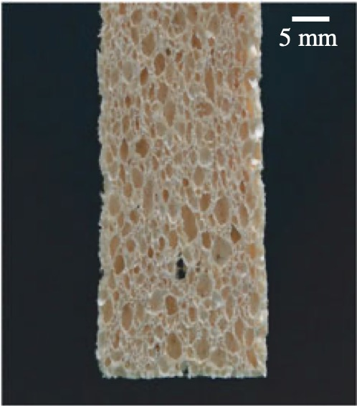
Real sponge
Pores of various sizes that need to be filled with liquid
Kim, J., Ha, J., & Kim, H. (2017). Capillary rise of non-aqueous liquids in cellulose sponges. Journal of Fluid Mechanics, 818, R2. doi:10.1017/jfm.2017.165

Slide 10
Real sponge
Because real fluids have viscosity, we need to take it into account.
It is easier for the fluid to flow into a large pore than a smaller one
Note that capillary action occurs in the weaves of the sponge not the pores
We can expect that: ability of sponge to soak up water will be increased by increasing the pore and decreasing viscosity
Small pore
Large pore

Slide 11
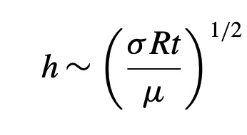
Real sponge - research
Kim, J., Ha, J., & Kim, H. (2017). Capillary rise of non-aqueous liquids in cellulose sponges. Journal of Fluid Mechanics, 818, R2. doi:10.1017/jfm.2017.165
In the limit that only large pores are being filled (early stages):
R – Characteristic size of the pores
$$σ−surface tension$$
$$μ −viscosity$$
Identical to Washburn equation
$$t−time$$
$$h−height of the liquid$$

Slide 12
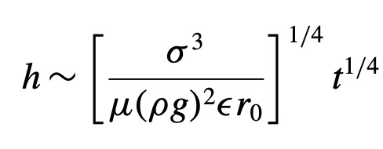
Real sponge - research
Kim, J., Ha, J., & Kim, H. (2017). Capillary rise of non-aqueous liquids in cellulose sponges. Journal of Fluid Mechanics, 818, R2. doi:10.1017/jfm.2017.165
In the late stages, unfilled pores are being compressed by the filled ones:
$$ε−pore compression ration$$
r_0 – radius of curvature responsible for driving force
$$h−height of the liquid$$
$$σ−surface tension$$
$$μ −viscosity$$
$$ρ and g −density and grav. acceleration$$
$$t−time$$

Slide 13
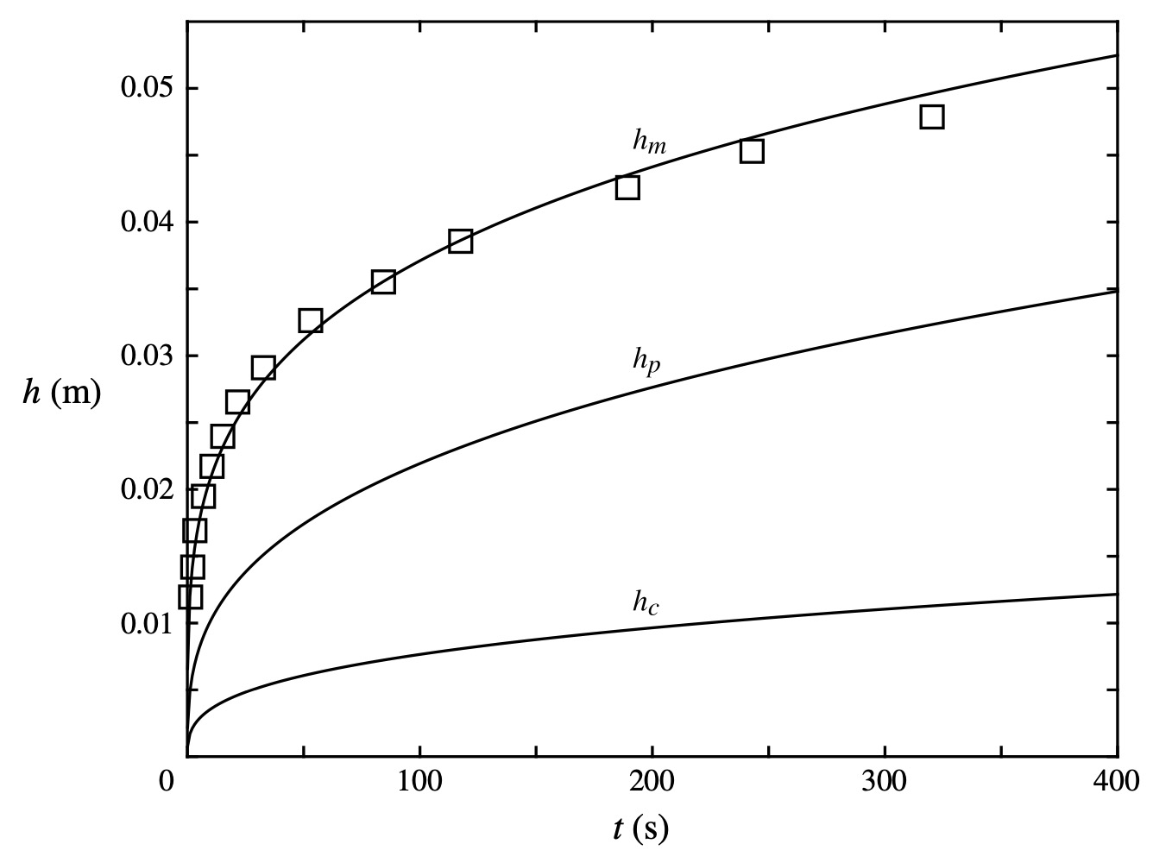
Real sponge - research
Kim, J., Ha, J., & Kim, H. (2017). Capillary rise of non-aqueous liquids in cellulose sponges. Journal of Fluid Mechanics, 818, R2. doi:10.1017/jfm.2017.165

Slide 14
Real sponge - research
More complicated model – sponge is expanding when wetted
Ha, J., Kim, J., Jung, Y., Yun, G., Kim, D. N., & Kim, H. Y. (2018). Poro-elasto-capillary wicking of cellulose sponges. Science advances, 4(3), eaao7051

Slide 15
Additional resources
https://stemfellowship.org/iypt-2021-references/sponge/

Slide 16
A sponge will soak up water at a rate and in a quantity determined by various parameters.
1
Why does a sponge soaks up water?
Most likely it’s capillary action.
2
What parameters affect the phenomenon?
Parameters of the fluid: surface tension, viscosity, in later stages density
Parameters of the sponge: size of the pores, in later stages compression ratio etc…

Slide 17
Fluid parameters
Liquid A
Liquid B
Liquid C
You can create solutions where you vary just viscosity or surface tension while keeping the other constant by combining 3 liquids e.g. water, glycerol, ethanol, sulfuric acid etc.

Slide 18
Size of the pores
Can be measured by taking a photo of a sponge under a microscope/very zoomed in and measuring a lot of pores in Tracker.
Measure mean pore size with uncertainty
Number
Pore size

Slide 19
Investigate how effective a sponge is at drying a wet surface.
3
Experimental investigation of the effectiveness.

Slide 20
Experiments
First, verify the relationships from the papers
Sponge
Water reservoir
Measure the height of liquid in the sponge against time, take photos at various times.
Note: to avoid experimental complications, measure it with a thin slice of a sponge.

Slide 21
Experiments
First, verify the relationships from the papers
Sponge
Water reservoir
Desired output for different fluids:
or
height
Volume
time
time

Slide 22
Experiments - Effectiveness
Optimisation problem
1
Define Effectiveness for example: $ζ= \frac{Volume soaked by a sponge}{Total “spilled” volume}$
2
Perform quantitative experiments
measure each point multiple times and take mean and standard deviation, always label the data so it can be reused afterwards
Always done for fixed soaking duration
Always done for fixed “spilled volume”
Effectiveness
For different fluids
Effectiveness
For different fluids
Volume of “spilled” liquid
How long the sponge was soaking the water for - time

Slide 23
Experiments - Effectiveness
2
Perform quantitative experiments
measure each point multiple times and take mean and standard deviation, always label the data so it can be reused afterwards
Always done for fixed soaking duration
Always done for fixed “spilled volume”
Effectiveness
For different fluids
Effectiveness
For different fluids
Volume of “spilled” liquid
How long the sponge was soaking the water for - time
Be careful to make the experiments repeatable → always do them the same way
If you have small amounts of spilled liquid → do the experiments quickly so evaporation has little effect

Slide 24
Something different?
First make sure you have done the basics and have a proper understanding of them
Additional experiments
Interesting to see what happens with different sponge. It can be expanding while soaking or not…see what happens. You can follow the Science Advances paper .
Expanded theoretical model
You can try to obtain a sophisticated theoretical predictions than just proportionalities. By modelling the flow in COMSOL or creating your own more advanced capillary model, though it can be difficult.

Slide 25
Summary
Read papers mentioned in this presentation and on stemfellowship website, read the papers that these papers are citing
Verify the results obtained by Kim et. al.
Build a setup for repeatable effectiveness experiments: control amount of spilled liquid, measure volume of soaked up water.
Modify the theory in the papers/make your own and compare it with your experiments.
Most important: label your data, save it, keep organised!

Slide 26
